Slide 1
Library Management System
Mr Array

Slide 2
About Myself
Mohamed Nasser (@Mr_Array)

Slide 3
Agenda
OVERVIEW
ER DIAGRAM
Module 1 - Student Login /Librarian Login /System User Login
Module 2 - Signup For New Uses
Module 3 - Admin Panel

Slide 4
OVERVIEW
It is a Desktop application (Library Management System) that is designed to help libraries to manage all processes efficiently. There are many problems that face librarians such as It is difficult for them to access books quickly, to know who borrowed books, and to know the quantity and location of books. our software solve all these problems and help Student to search for any book, issue books ,show all books in library and help The librarian to Add or Delete books, Return books and help Admin to Add or Remove librarian and Student .

Slide 5
We Used Technolgies
We Used Technologies:
- C# . Net ( Desktop application )
- Windows Form
- SQL Server (DBMS)

Slide 6
ER DIAGRAM
– It is clear that the physical objects from the previous section – the member, books, library – correspond to entities in the Entity-Relationship model, and the operations to be done on those entities – holds, checkouts, and so on – correspond to relationships. However, a good design will minimize redundancy and attempt to store all the required information in as small a space as possible.

Slide 7
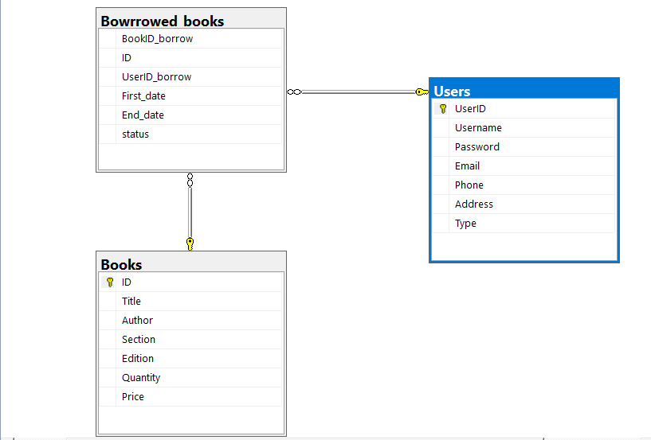

Slide 8
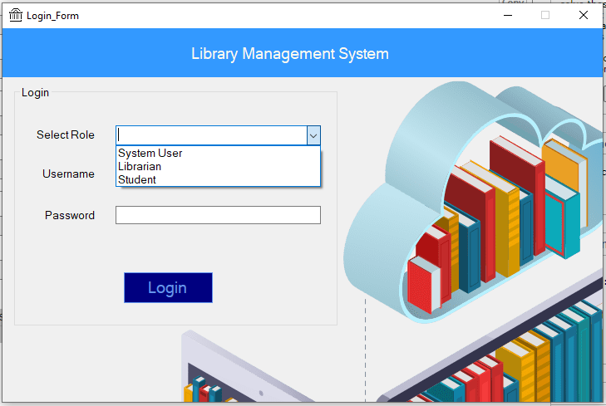

Slide 9
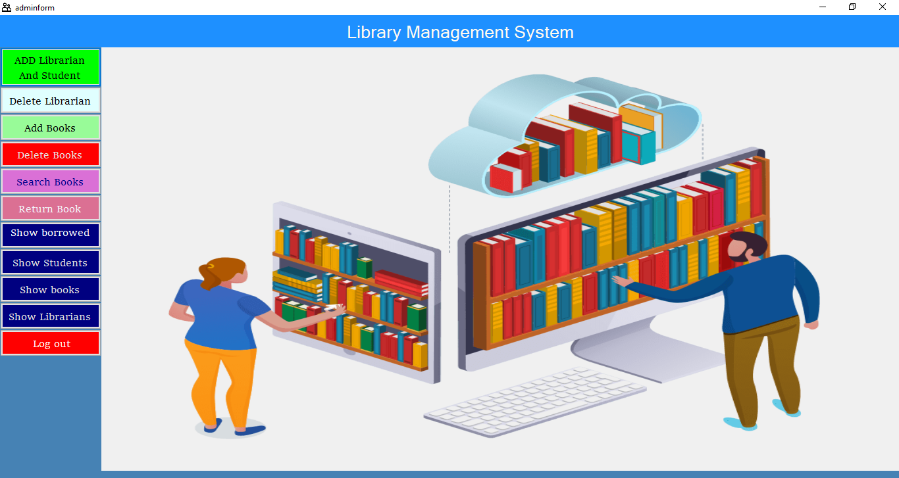

Slide 10
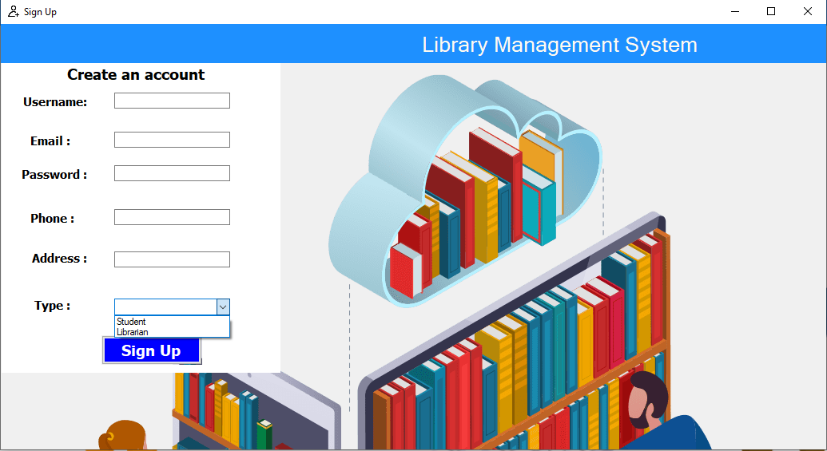

Slide 11
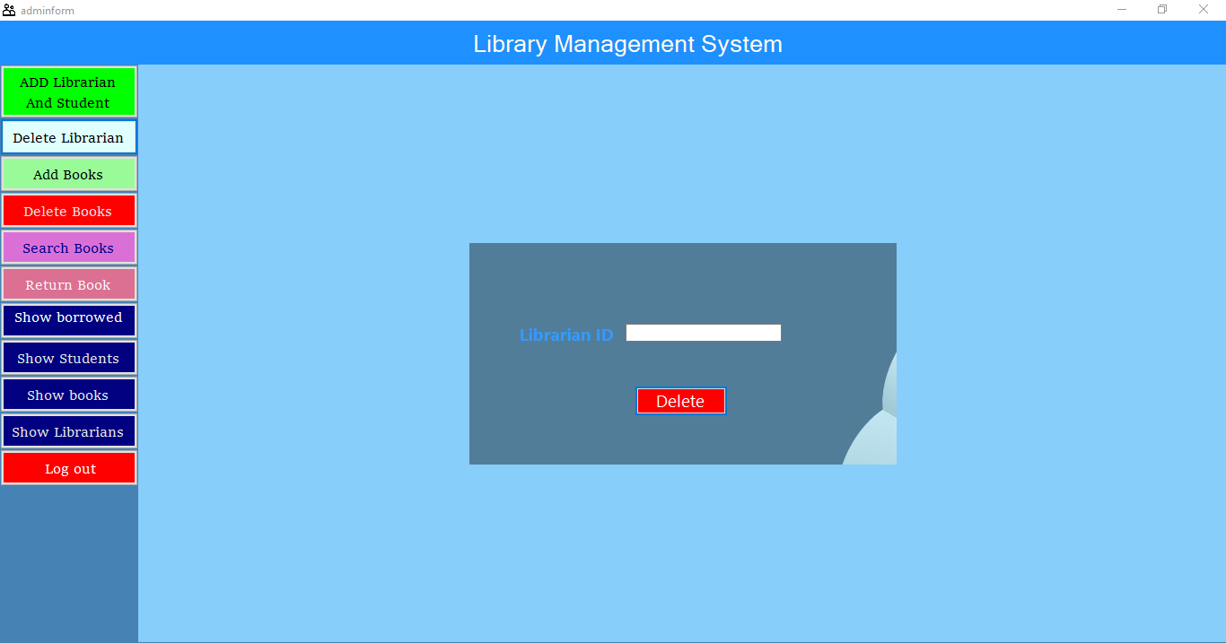

Slide 12
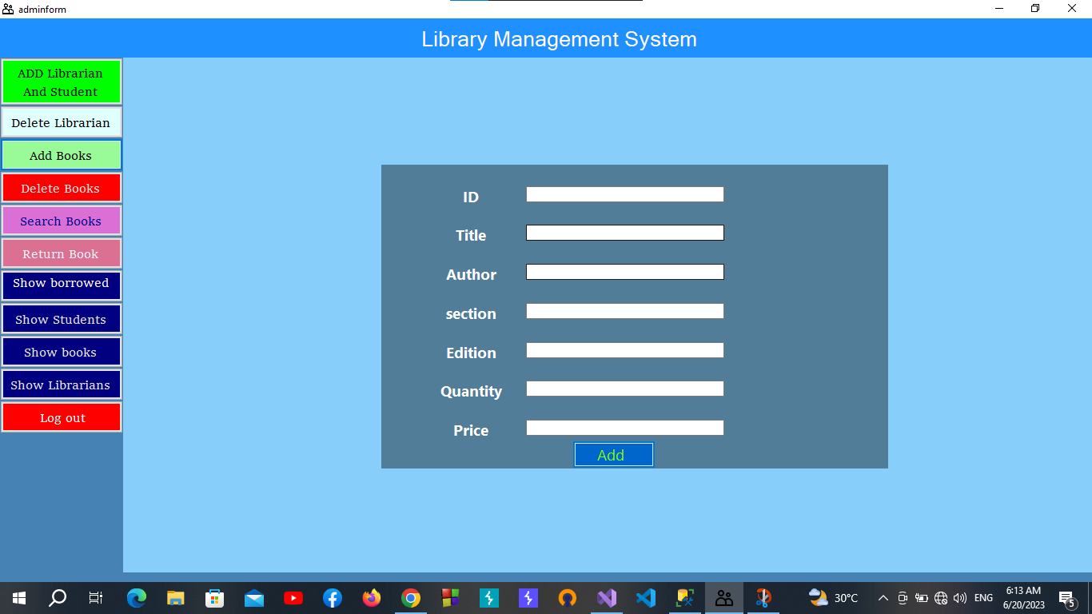

Slide 13
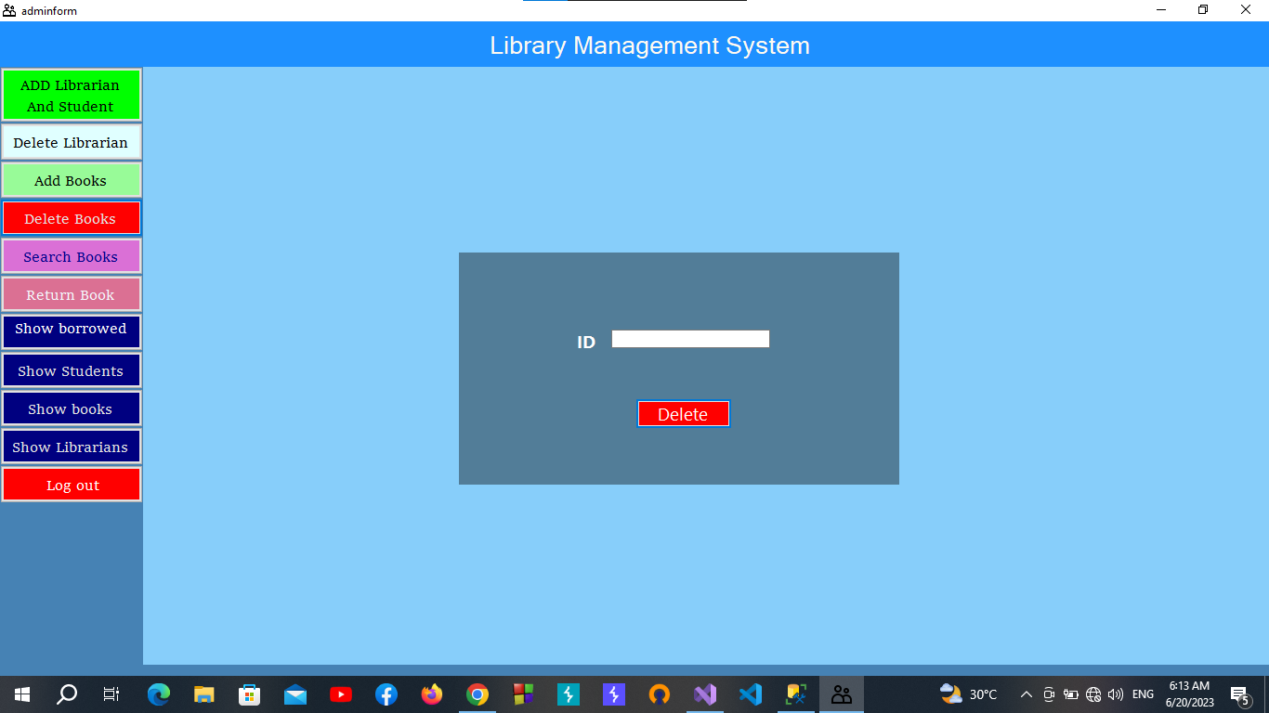

Slide 14
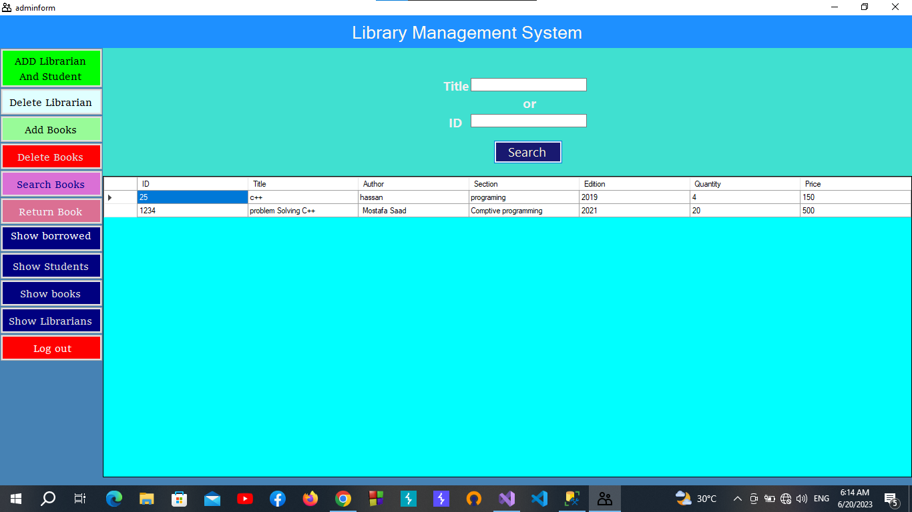

Slide 15
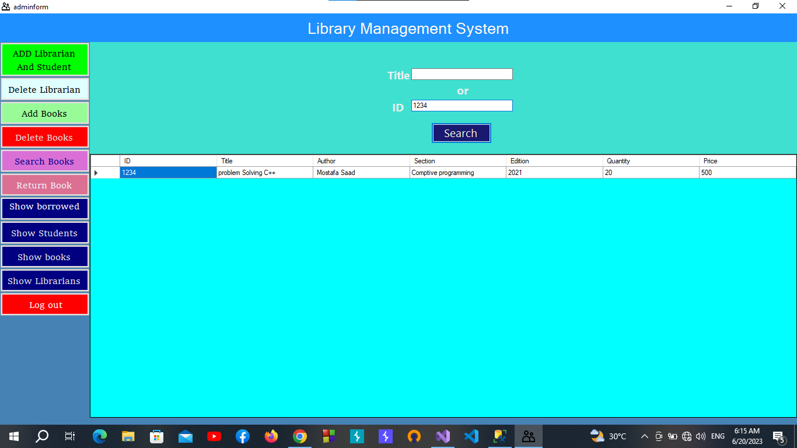

Slide 16
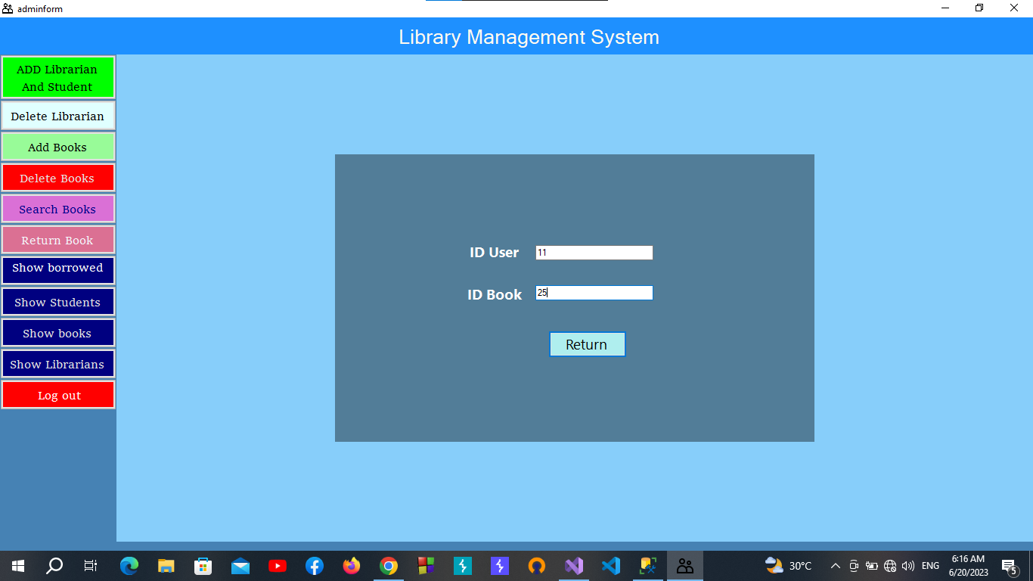

Slide 17
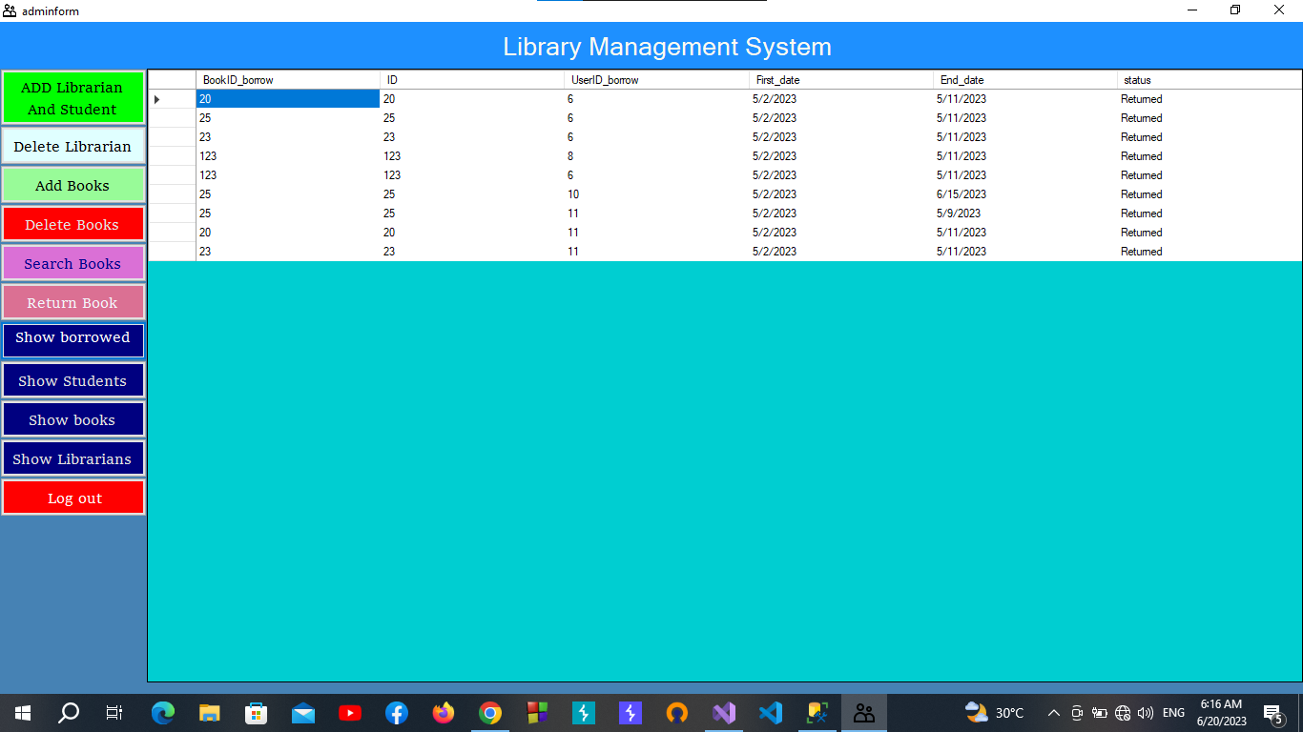

Slide 18
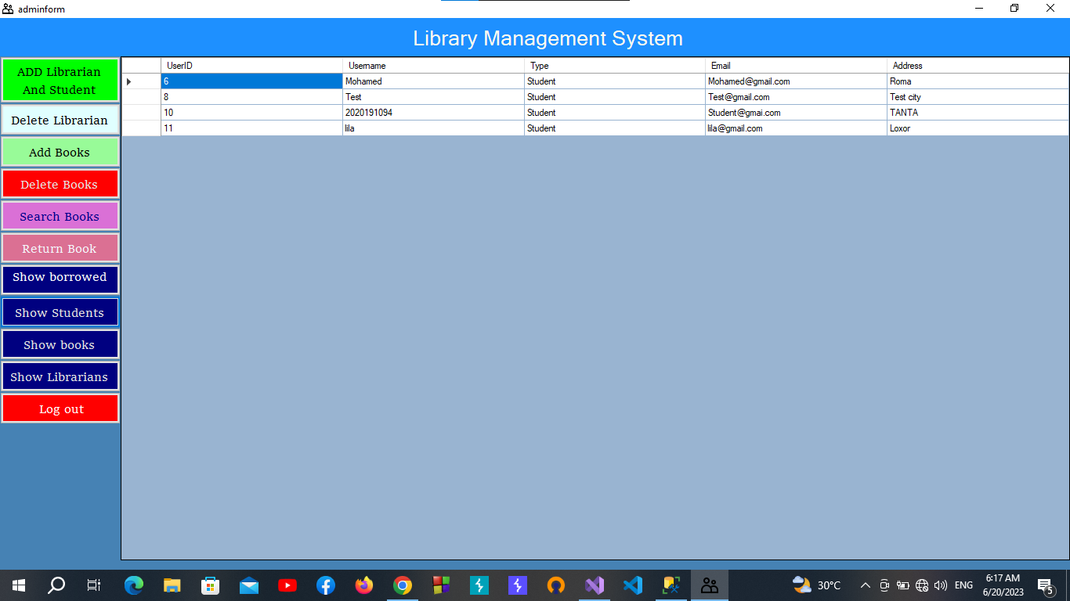

Slide 19
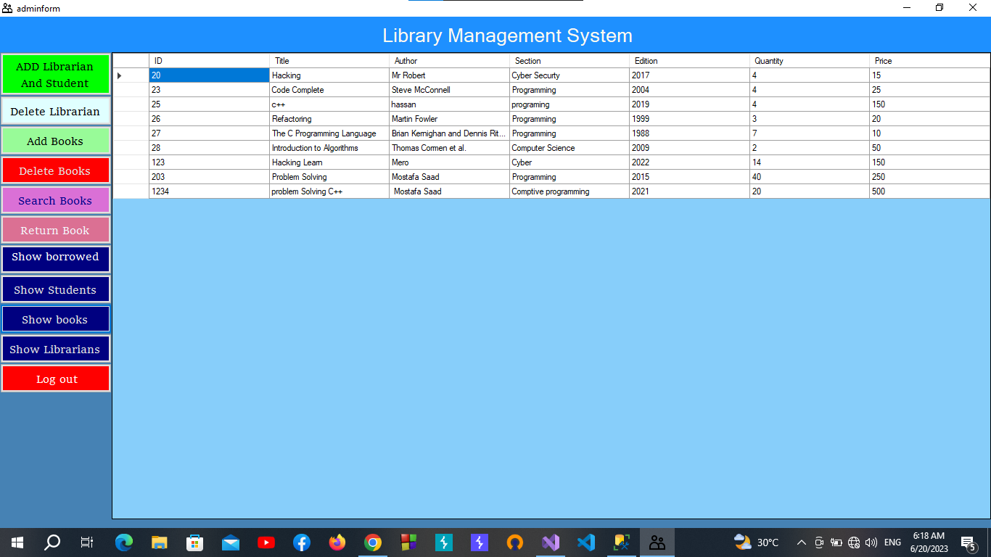

Slide 20
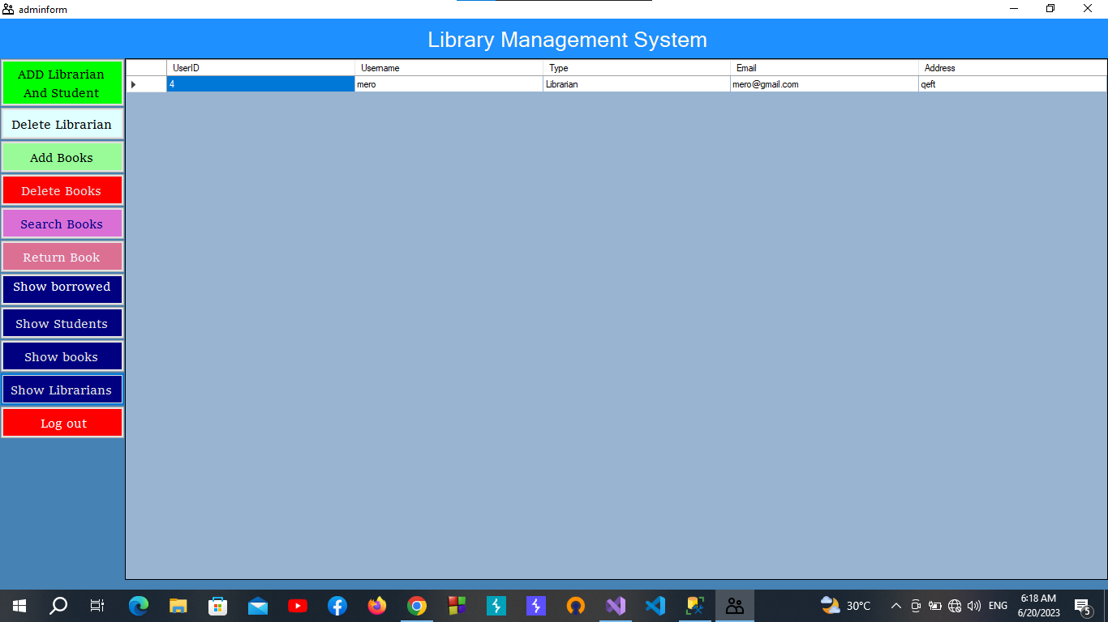

Slide 21
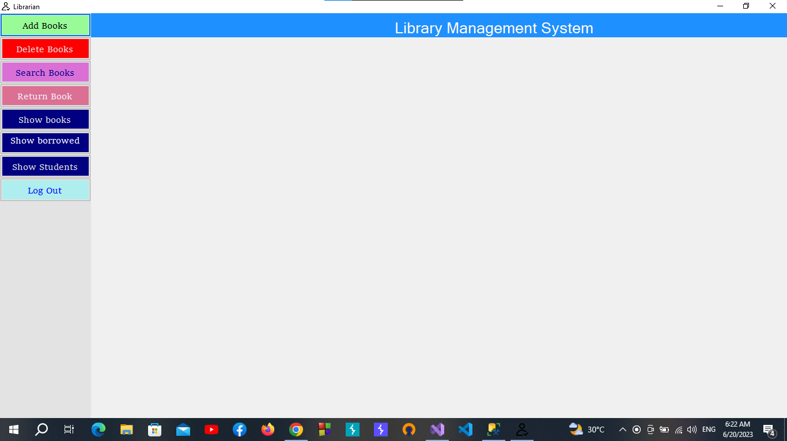

Slide 22
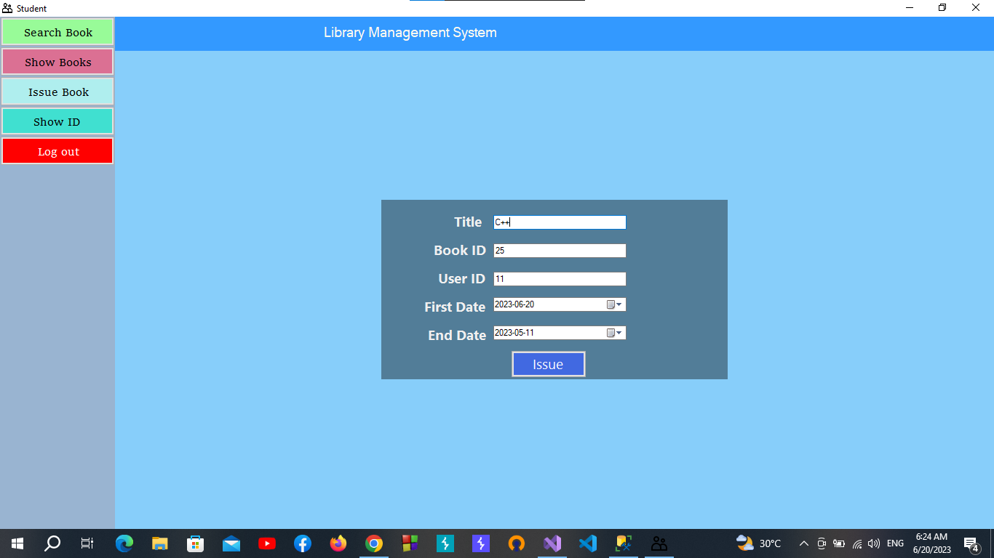

Slide 23
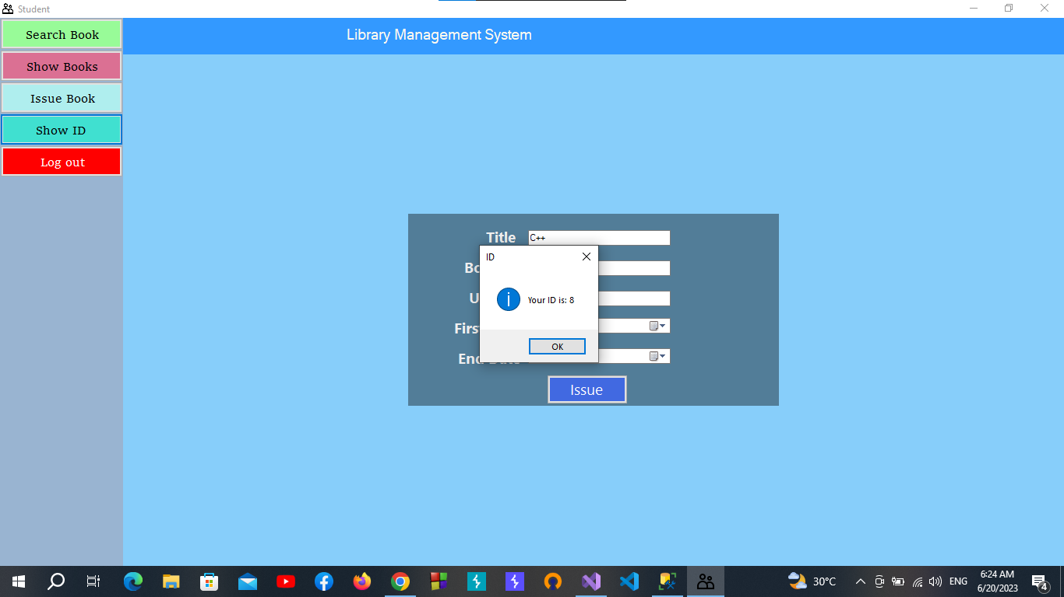

Slide 24
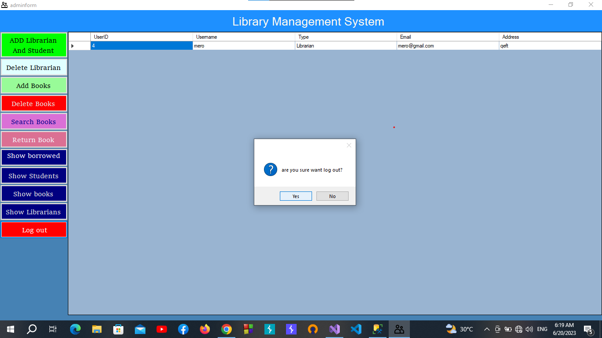

Slide 25


Slide 26


